Slide 1
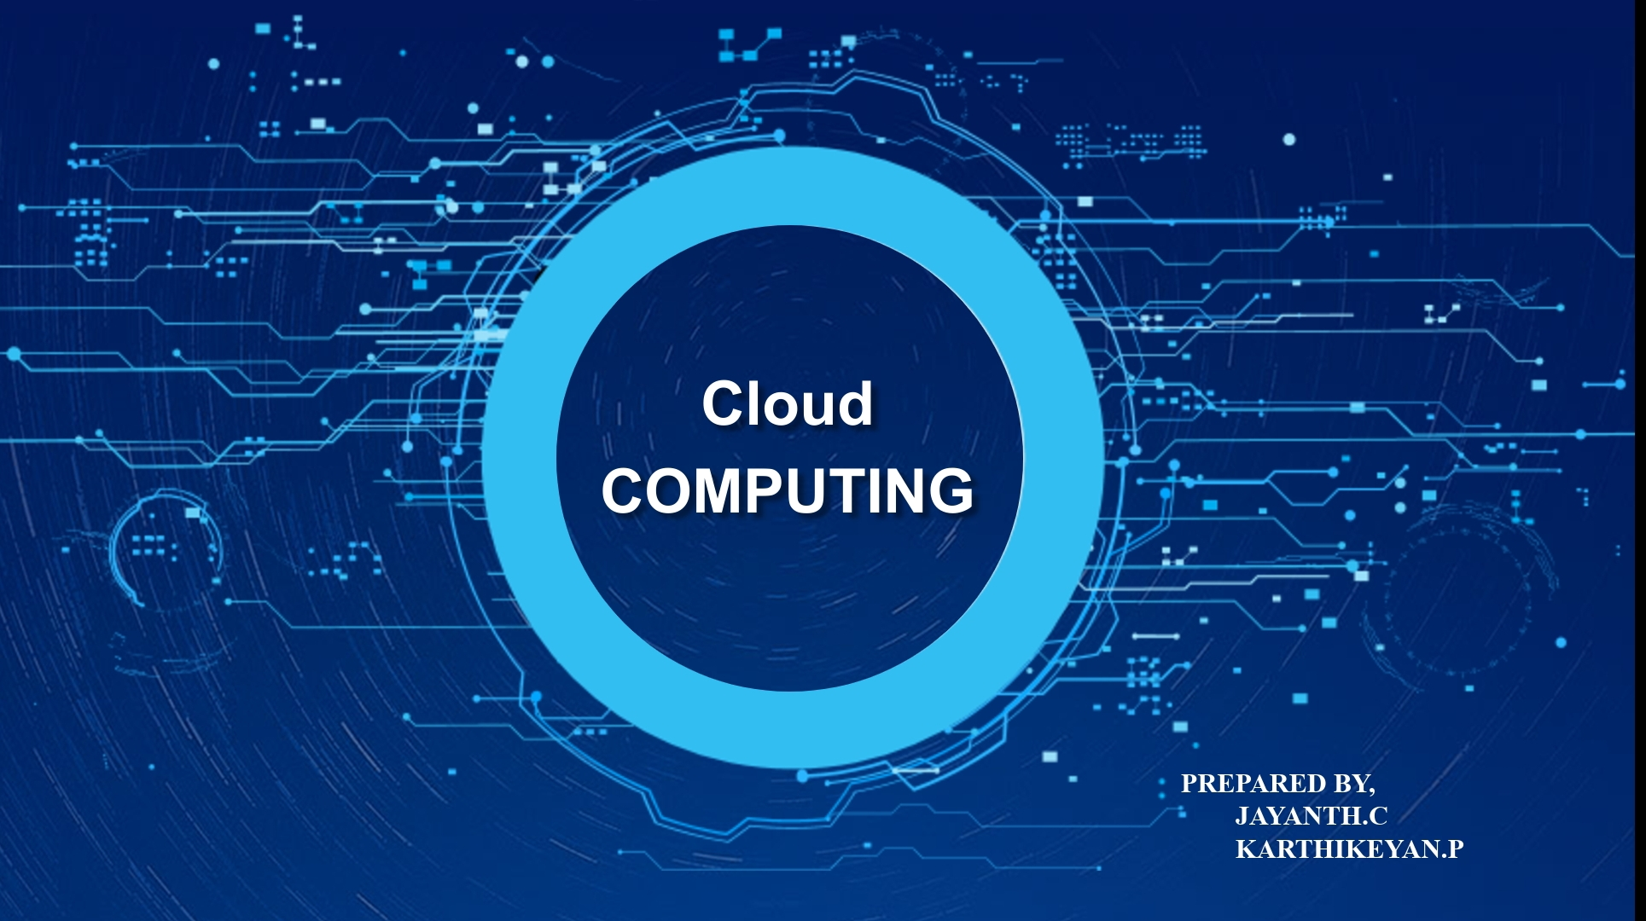

Slide 2

INTRODUCTION
What is cloud computing
Content
Related to Mechanical Engineering
OUR Thoughts on cloud computing

Slide 3
Cloud
computing
. Cloud computing is a revolutionary technology that has transformed the way businesses and individuals store, access, and manage data and applications. At its core, cloud computing refers to the delivery of various computing services over the internet, as opposed to traditional on-premises computing

Slide 4

Service
models
Deployment
Models
Key
Benifits
Common
Cloud Storage

Slide 5
Service models
Infrastructure as a Service (IaaS)
Platform as a Service (PaaS)
Software as a Service (SaaS)

Slide 6
Infrastructure as a Service
Software as a Service
Provides virtualized computing resources over the internet, such as virtual machines, storage, and networking.
Delivers software applications over the internet on a subscription basis, eliminating the need for local installations.
2
3
1
Platform as a Service
Offers a platform and environment for developers to build, deploy, and manage applications without worrying about the underlying infrastructure.

Slide 7

Deployment Models:
Public Cloud:.
Private Cloud:
Hybrid Cloud:.

Slide 8

Deployment Models:
Public Cloud: Services are provided by third-party cloud providers and are accessible to anyone over the internet.
Private Cloud: Resources are dedicated to a single organization, typically hosted on-premises or in a data center, providing greater control and security.
Hybrid Cloud: Combines elements of both public and private clouds, allowing data and applications to be shared between them.

Slide 9
Flexibility, Reliability and Redundancy
Cloud computing allows users to access their data and applications from anywhere with an internet connection, promoting remote work and collaboration.
Cloud providers typically offer high levels of data redundancy and uptime, reducing the risk of data loss and service interruptions.

Slide 10
Common Cloud Services:

Slide 11

Cloud Storage
Compute Services
Databases
Content Delivery
Machine Learning and AI

Slide 12
Cloud Storage
Services like Amazon S3, Google Cloud Storage, and Microsoft Azure Blob Storage provide scalable and secure data storage.
Compute Services
Providers offer virtual machines (e.g., AWS EC2, Azure VMs) and serverless computing (e.g., AWS Lambda, Azure Functions) for running applications and workloads.

Slide 13
MACHINE LEARNING AND AI
Cloud platforms offer machine learning and artificial intelligence tools for data analysis and predictive modeling.
Databases
Cloud-based database services like Amazon RDS, Azure SQL Database, and Google Cloud SQL simplify database management.

Slide 14
HOW IT RELATED TO MECHANICAL ENGINEERING

Slide 15
Simulation and Analysis
Collaboration and Remote Work
Mechanical engineers often need to perform complex simulations, such as finite element analysis (FEA) and computational fluid dynamics (CFD), which can be computationally intensive. Cloud computing provides the necessary computing power to run these simulations efficiently without requiring high-end local hardware. This allows engineers to perform in-depth analyses and optimization of mechanical systems.
Version Control
Cloud-based collaboration tools and project management platforms enable mechanical engineers to work together on designs, share CAD models, and communicate effectively, regardless of their physical locations. This is especially valuable for global teams and remote work situations.
Cloud-based version control systems help mechanical engineers manage design revisions and track changes in collaborative projects, ensuring that the team always works with the latest and accurate design files.

Slide 16
Project Title: "Cloud-Based Predictive Maintenance for Industrial Machinery"

Slide 17
Project Description:
Industrial machinery and equipment in manufacturing settings require regular maintenance to ensure they operate efficiently and avoid unexpected breakdowns. Traditional maintenance practices are often based on fixed schedules or reactive responses to machine failures. In this project, you will develop a cloud-based predictive maintenance system for a specific industrial machine.
BENIFITS
Reduces unexpected machine downtime, leading to increased productivity.
Optimizes maintenance schedules, potentially reducing maintenance costs.
Extends the lifespan of industrial machinery through proactive maintenance.
Showcases the integration of cloud computing, data analysis, and mechanical engineering skills.

Slide 18








THANK YOU
DO YOU HAVE ANY QUESTIONS

